Slide 1
PSP Remote Configuration

Slide 2
Install PSP software
Install PSP Application software from link below: \\Inblrnfs01\MWP-R&D-PROJECTS\EV-Design-Team\Team\Tools_SW\PowerSupply_UI

Slide 3
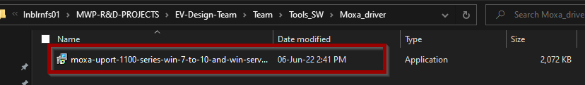
Installation of MOXA driver
Install the moxa driver from link below: \\Inblrnfs01\MWP-R&D-PROJECTS\EV-Design-Team\Team\Tools_SW\Moxa_driver

Slide 4
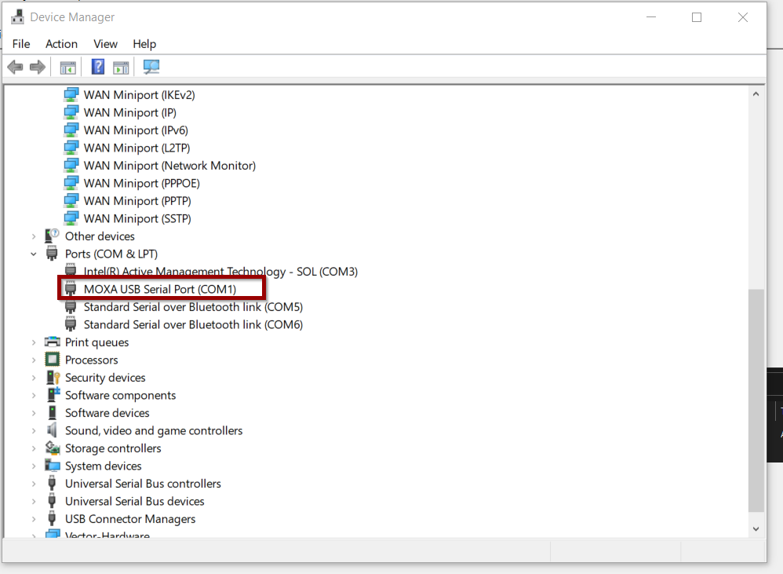
Verify the driver installation
Connect the device to check the driver installation
Can be verified from the Device Manager→Ports→Moxa USB

Slide 5
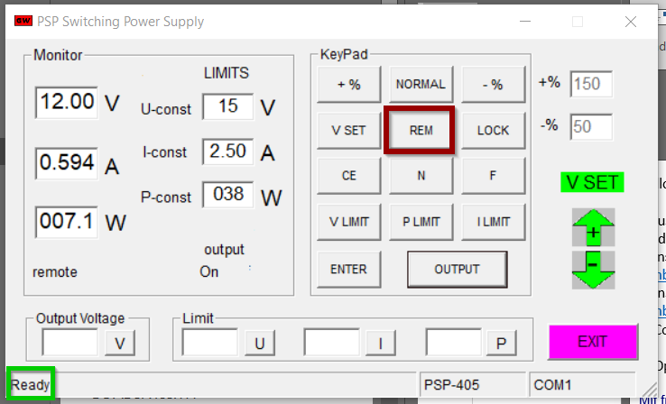
PSP Application
Open PSP Application and verify the connection and working
Verify the status as Ready. Click REM to connect and disconnect.

Slide 6
Smarter. Greener. Together.

